Slide 1



Library Management System
Project review
PRESENTED BY
PRIYANKA K 23ITR121
NANDEESH G 23ITR107
MOHAMMED YUNUS A 23ITR099
1

Slide 2
OBJECTIVE
To develop an efficient and user-friendly system that automates library management processes, minimizes manual errors, and ensures smooth operations in book management, member handling, and reservation systems.
2

Slide 3
Problem Statement
In a traditional library, the management of books and users can become complex and time-consuming. Common issues include:
Difficulty in tracking the availability of books.
Inefficient search methods leading to delayed services.
Lack of a structured reservation and waiting list system.
Manual member management, which is prone to errors.
3

Slide 4
Data Structures, Algorithms, and Concepts Used
Leveraging key data structures and algorithms for efficiency.
Data Structure
Purpose
Arrays
Storing book records
Linked Lists
Managing book reservations
Queues
Handling book reservation requests
4

Slide 5




Software and Tools
Utilizing industry-standard tools for development and deployment.
Java
MySQL
Programming Language
Database Management System
intellj IDEA
Git
Integrated Development Environment
Version Control System

Slide 6
Modules and Functions
Organized into modular components for improved maintainability.
Book Management Module
Availability Module
Membership Module
User Module
Admin Module
6

Slide 7
About Modules
Book Management Module:
Manages book records, including adding, updating, and deleting.
Availability Module:
Tracks real-time book availability and manages reservations.
User Module:
Displays issued books and tracks user borrowing history.
Admin Module:
Manages users and displays admin details for oversight.
Membership Module:
Handles user registration and membership status management.

Slide 8
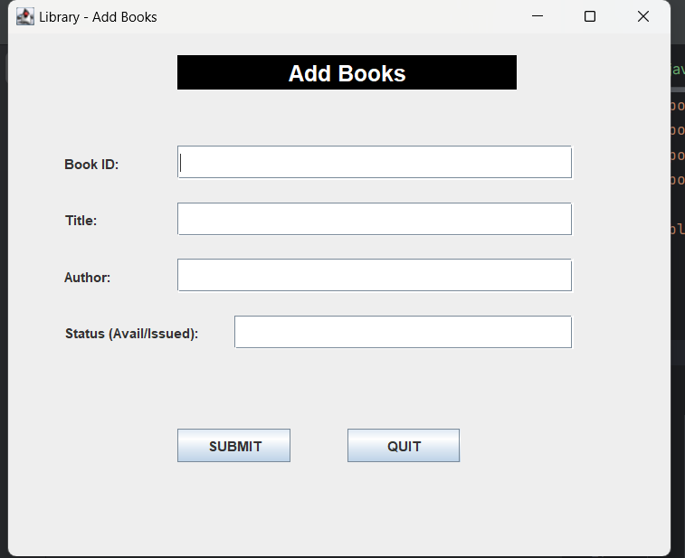
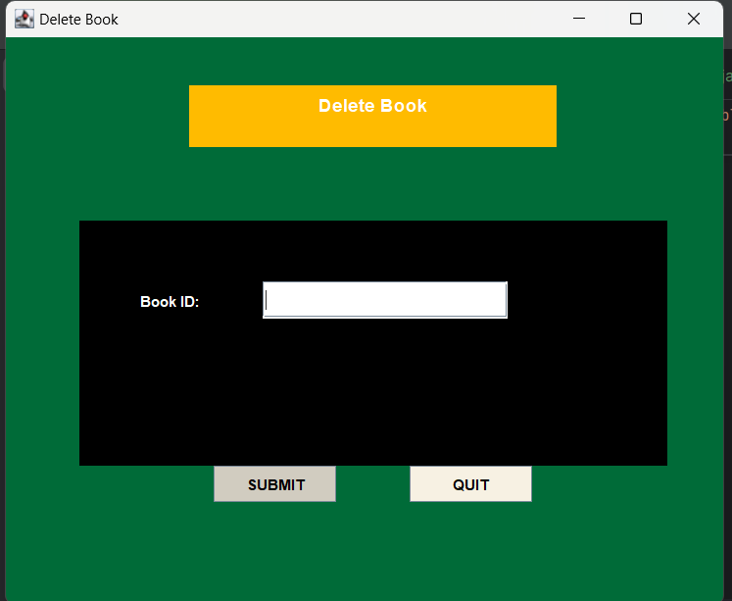
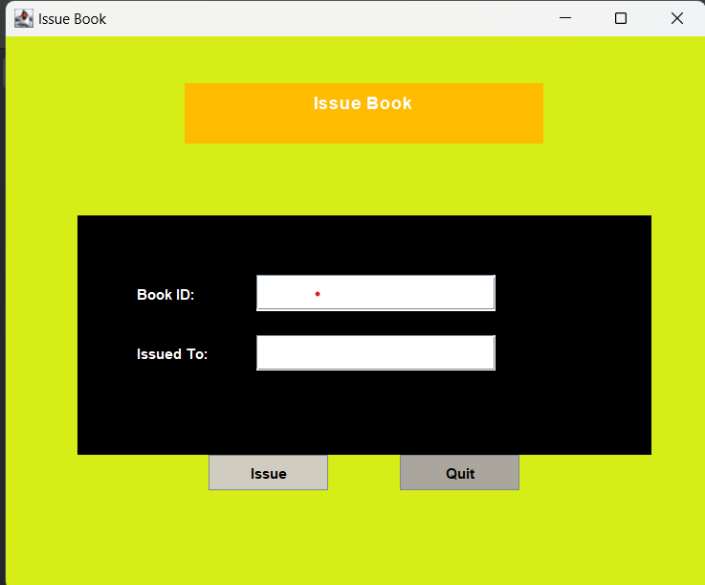
Output
Book management module
User Module

Slide 9
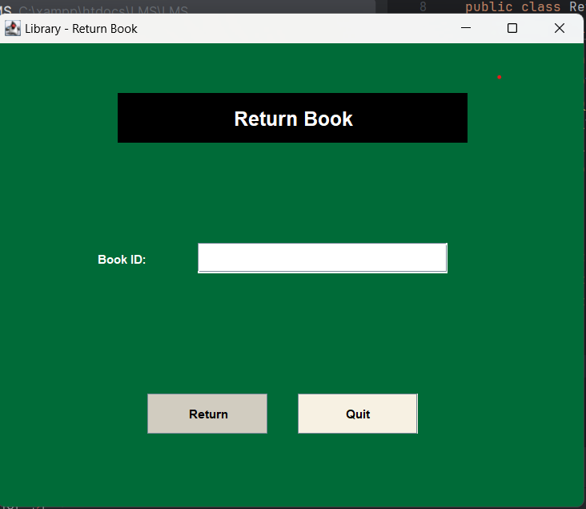
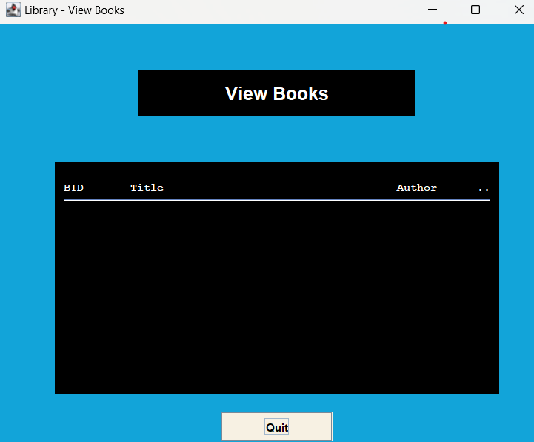
Availability Module

Slide 10



Conclusion
Successful project delivering a modern and efficient library management system.
Improved Efficiency
Enhanced Accessibility
Future Development
Streamlined book management and user experience.
Easier access to library resources for members.
Potential for mobile app integration and advanced features.
10

Slide 11
THANK YOU

